Slide 1
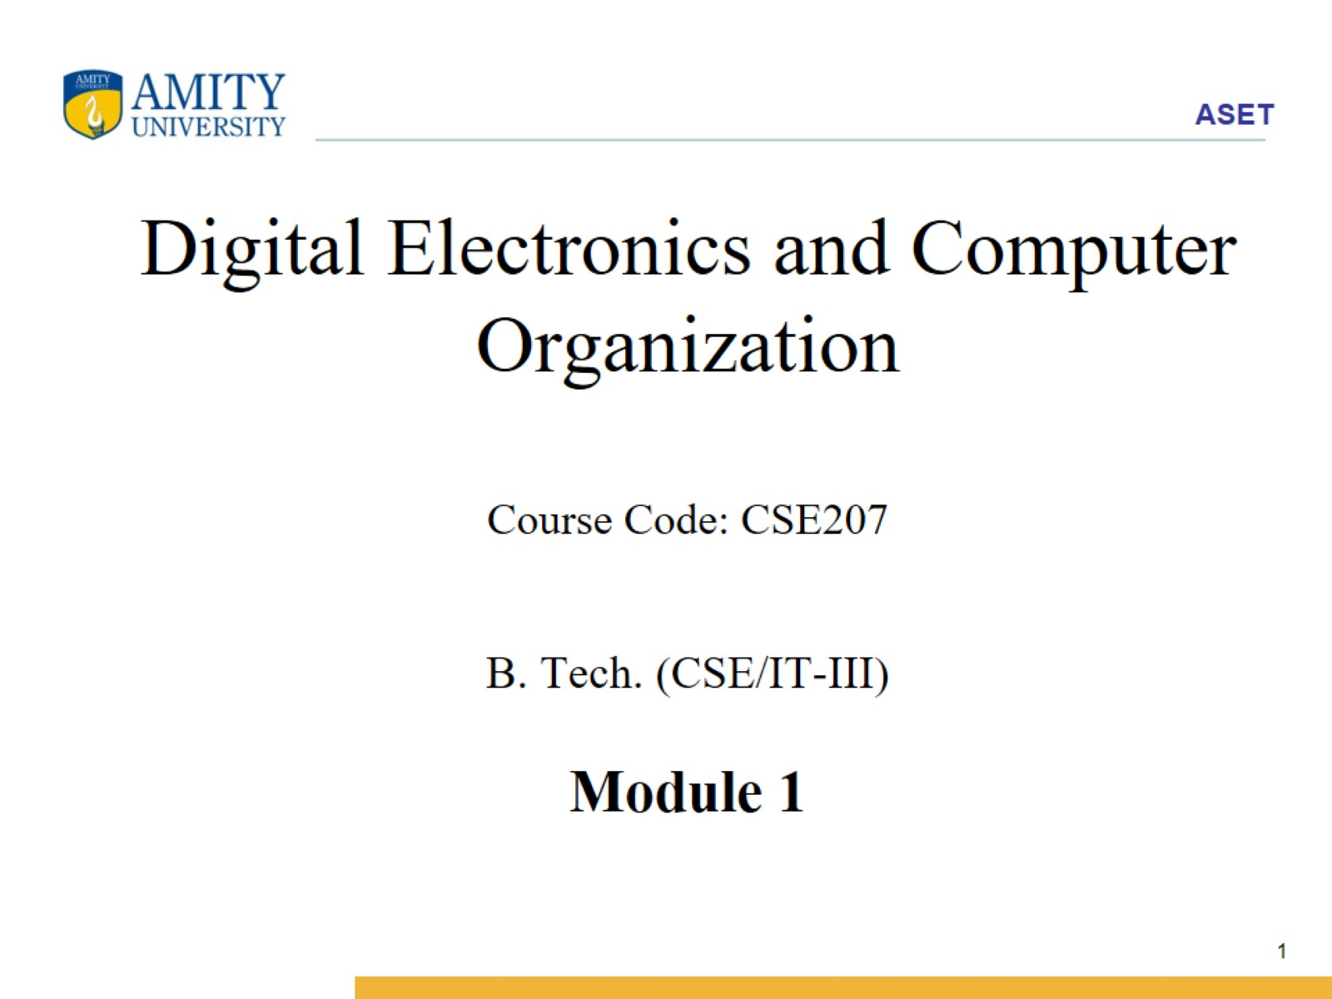
Digital Electronics and Computer Organization Course Code: CSE207 B. Tech. (CSE/IT-III) Module 1

Slide 2
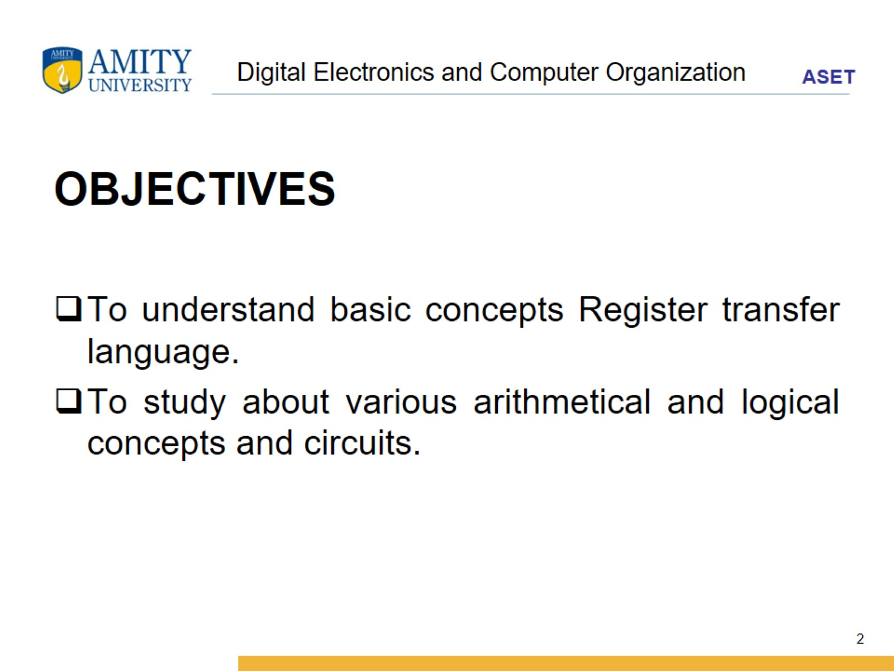
Digital Electronics and Computer Organization

Slide 3
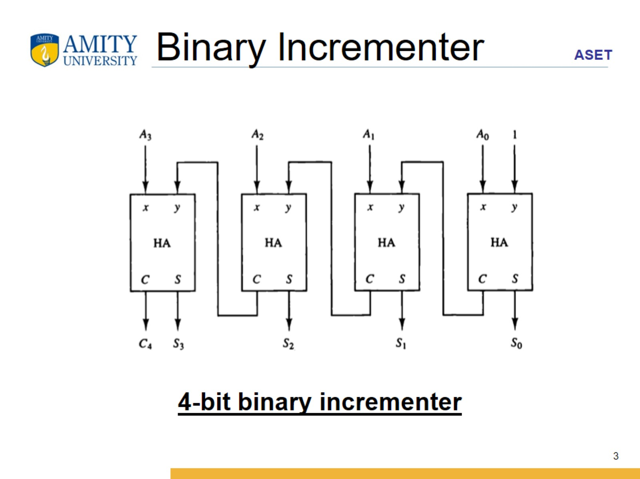
Binary lncrementer

Slide 4
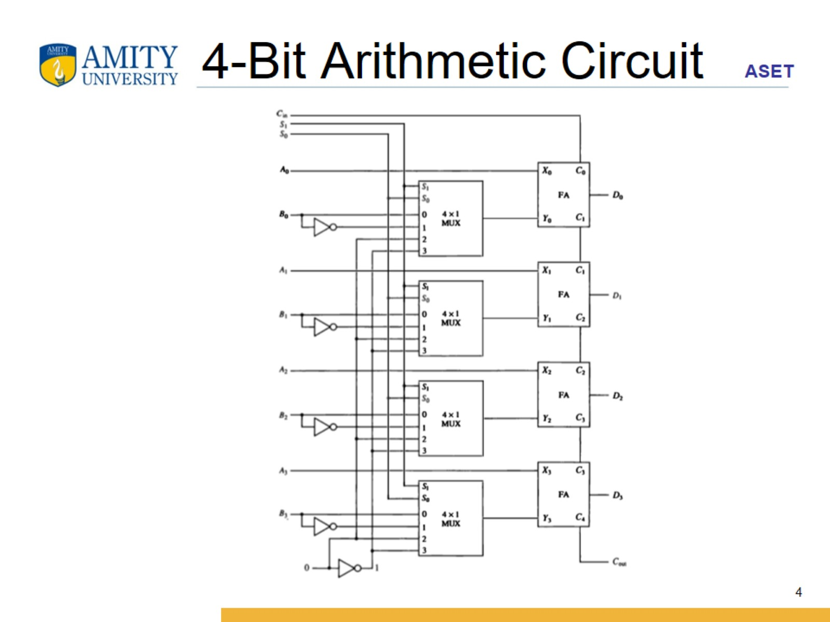
4-Bit Arithmetic Circuit

Slide 5
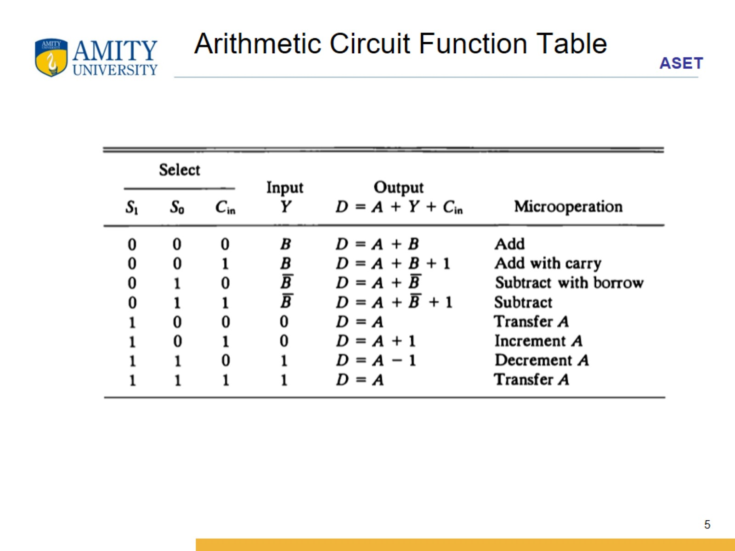
Arithmetic Circuit Function Table

Slide 6
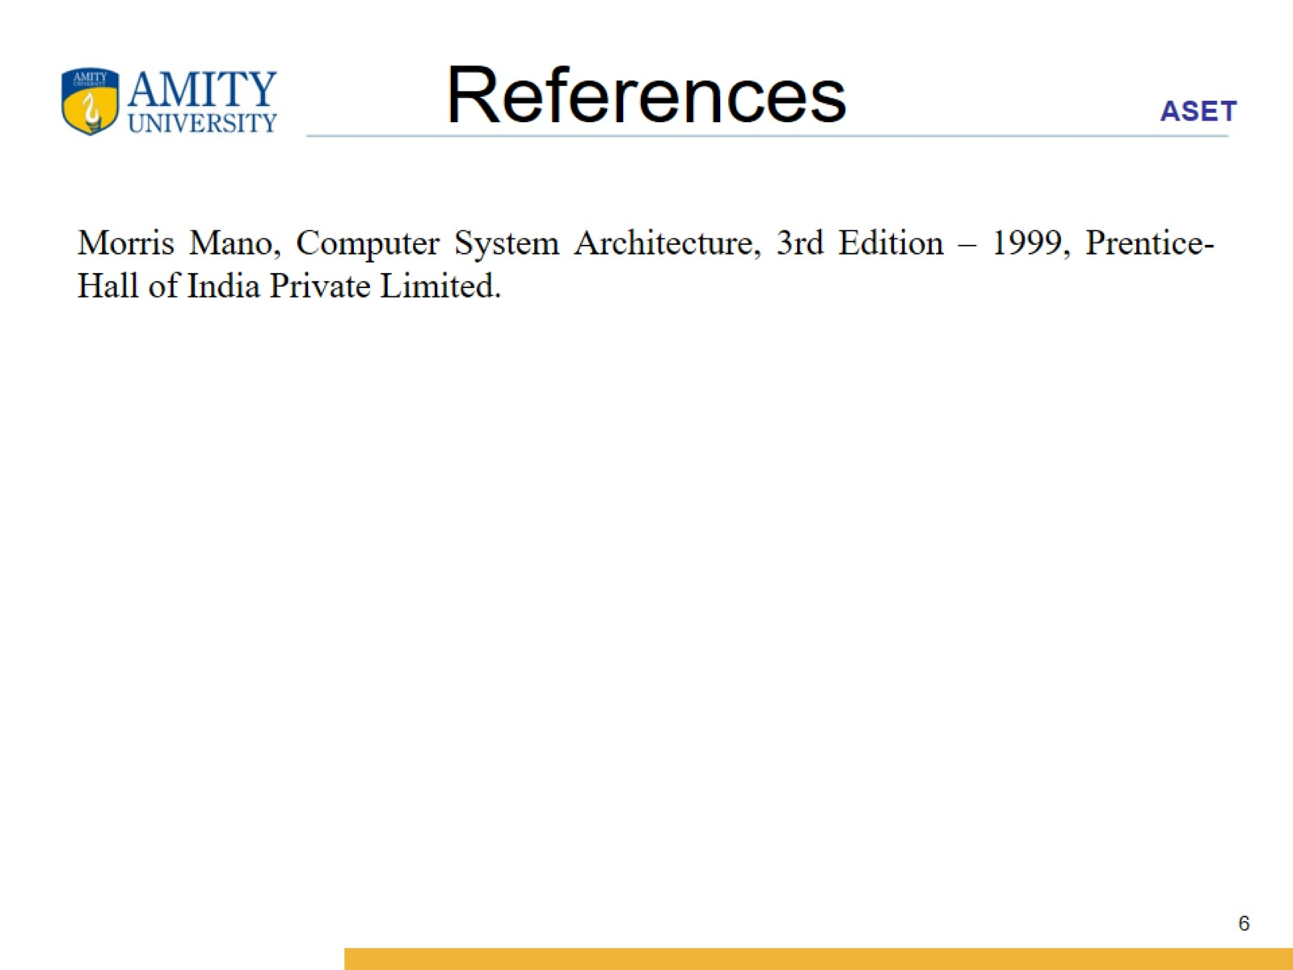
References

